Slide 1
ECHO Magnet
Extremely Curved Hadrontherapy Optics Magnet
Proposal for young researchers grant – CSN5
L. Balconi

Slide 2




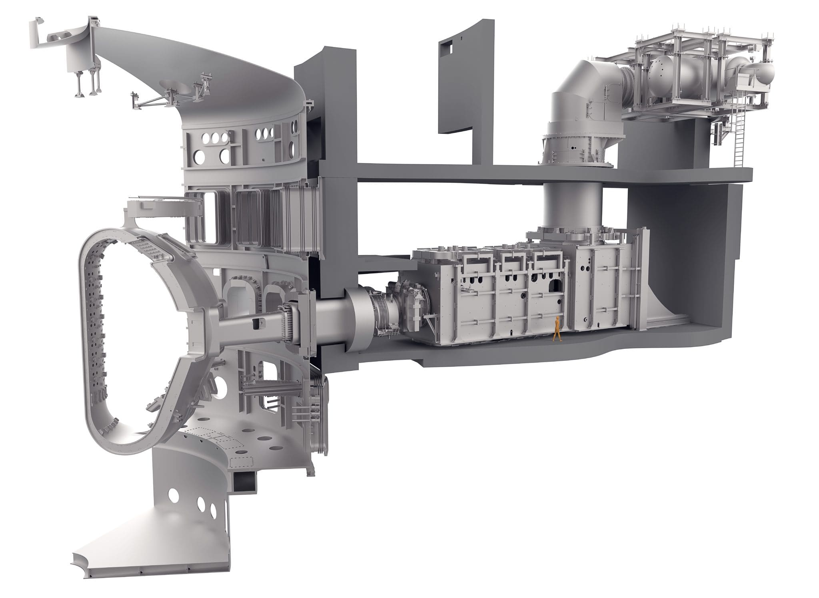
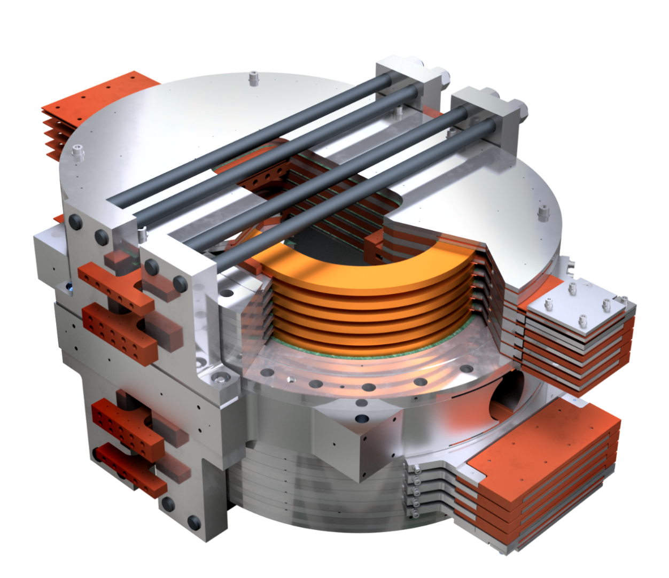
About me:
2020 – Bachelor degree in Physics
  University of Milan, Medical Physics
  ”Feasibility study of an innovative range monitoring technique using prompt gamma in hadrontherapy”
PAPRICA detector
2022 – Master degree in Fusion Plasma Physics
  University of Milan, CNR Padova – Consorzio RFX
  ”Set-up of the spectroscopic diagnostics for MITICA”
2022 – Present PhD in Applied Physics (Final defense expected early jan 2026)
  University of Milan, LASA laboratory
  ”Design and study of the IRIS 10 T Energy Saving dipole Magnet for Accelerators ESMA”
  CSC Graduate Study Fellowship Award
  by IEEE, Council on SuperConductivity (CSC)
MITICA Neutral Beam Injector
ESMA dipole magnet

Slide 3
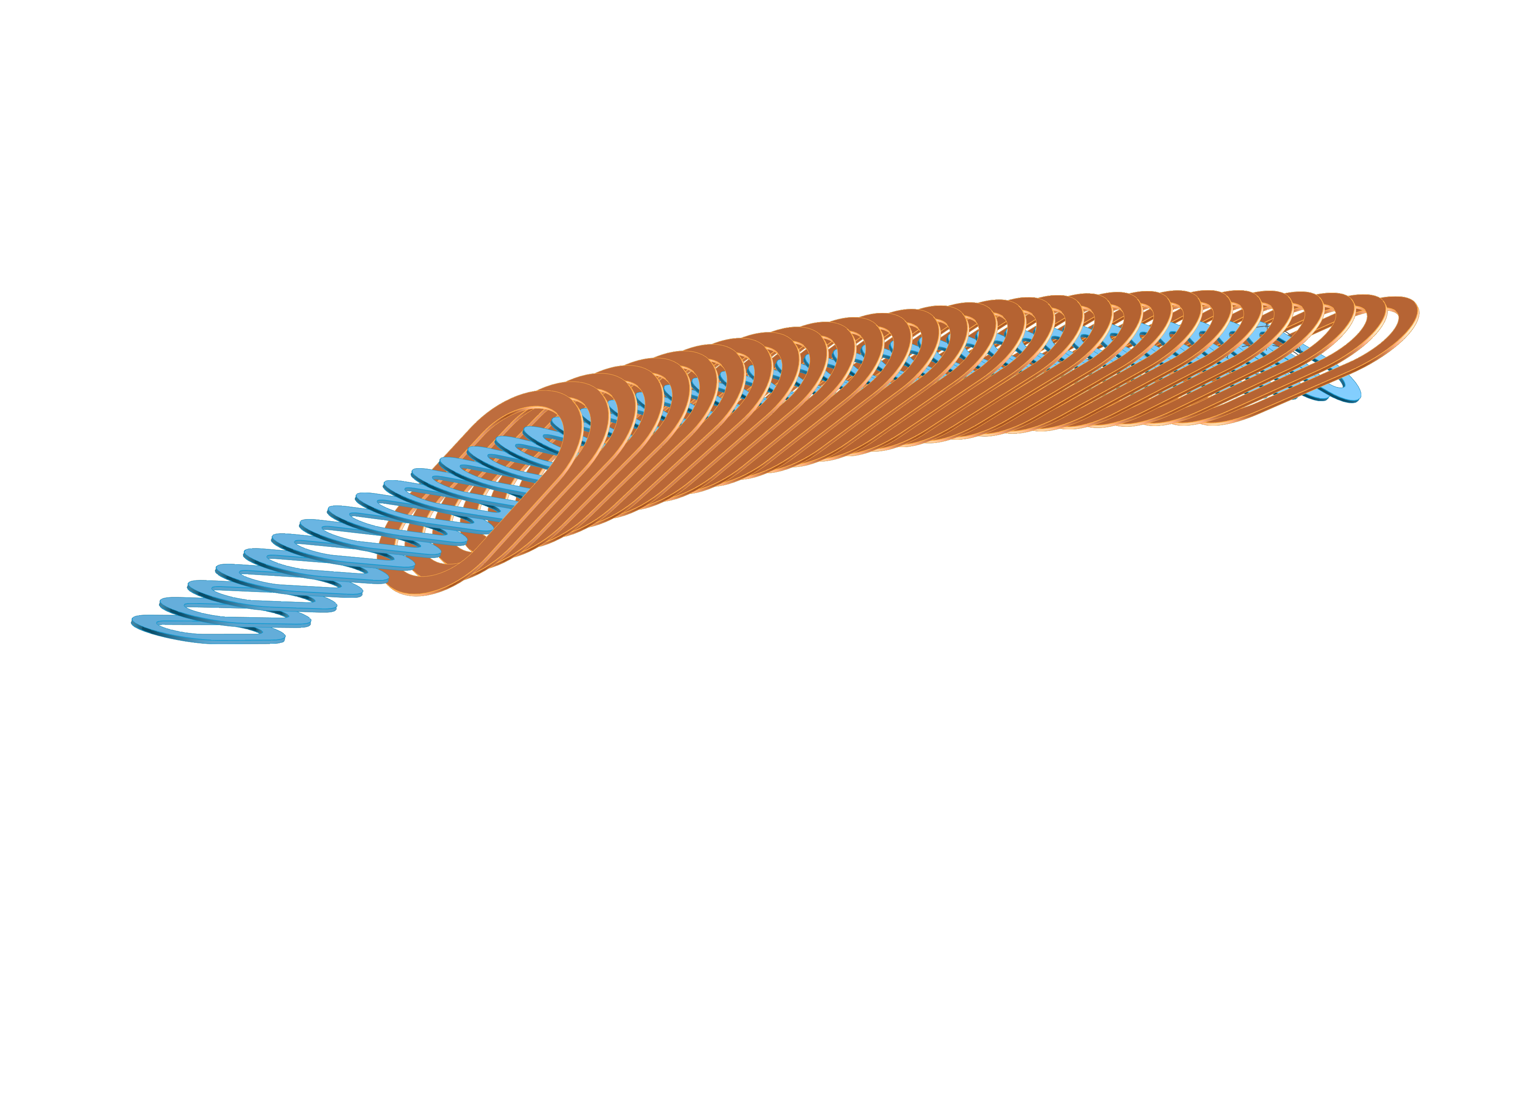
Outline
Status of the art,
Why ECHO Magnet?
Realization plan of ECHO
    Design
    Manufacturing
Timeline, risks and costs analysis
Conclusions

Slide 4
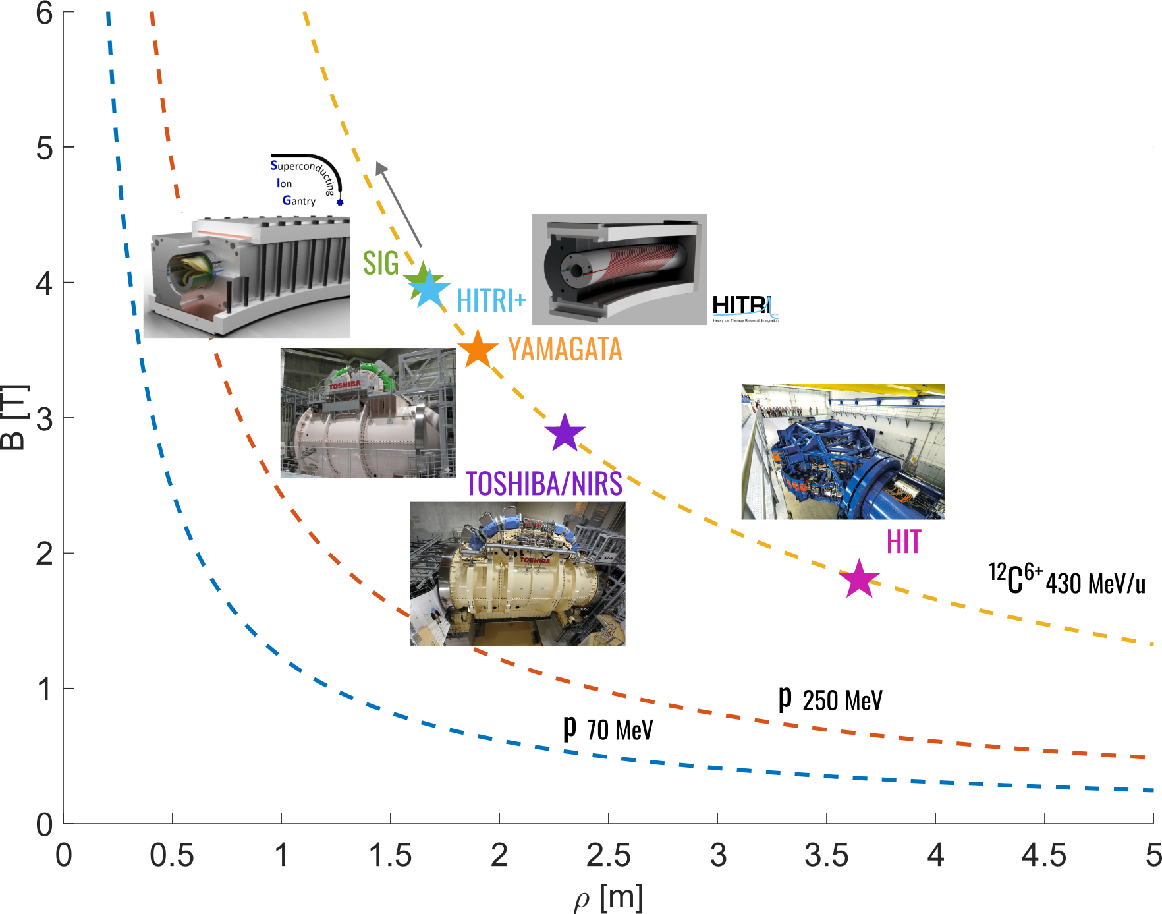
State-of-the-art & actual R&D
Resistive magnets for ion gantry:
  HIT: B = 1.8 T, ρ = 3.65 m
  650 tons
HTS?
Low Temperature Superconductors (LTS)
  Toshiba/NIRST: B = 2.88 T, ρ = 2.3 m,
    300 tons
  Yamagata: B = 3.5 T, ρ = 1.9 m
    200 tons
  SIG: B = 4 T, ρ = 1.65 m
  HITRI+: B = 4 T, ρ = 1.65 m
High Temperature Superconducting (HTS) tapes are promising candidates
m ~ 100 tons
Notes:
Dire che gli HTS sono nastri → avvolgimenti piani ok

Slide 5
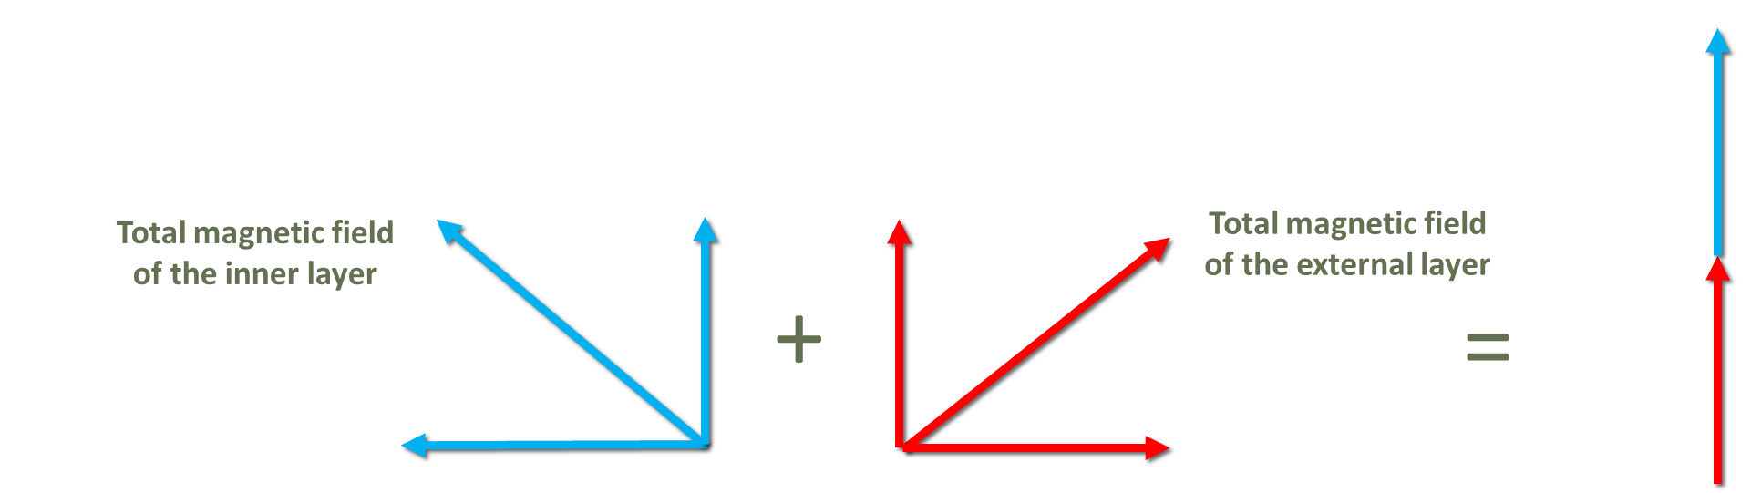
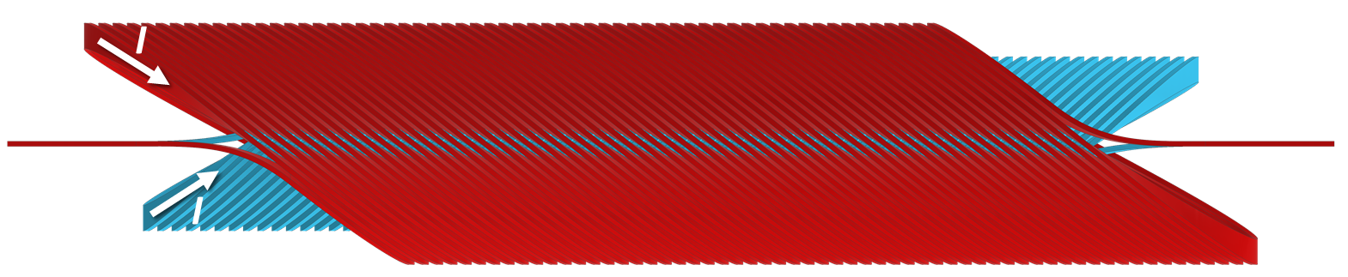
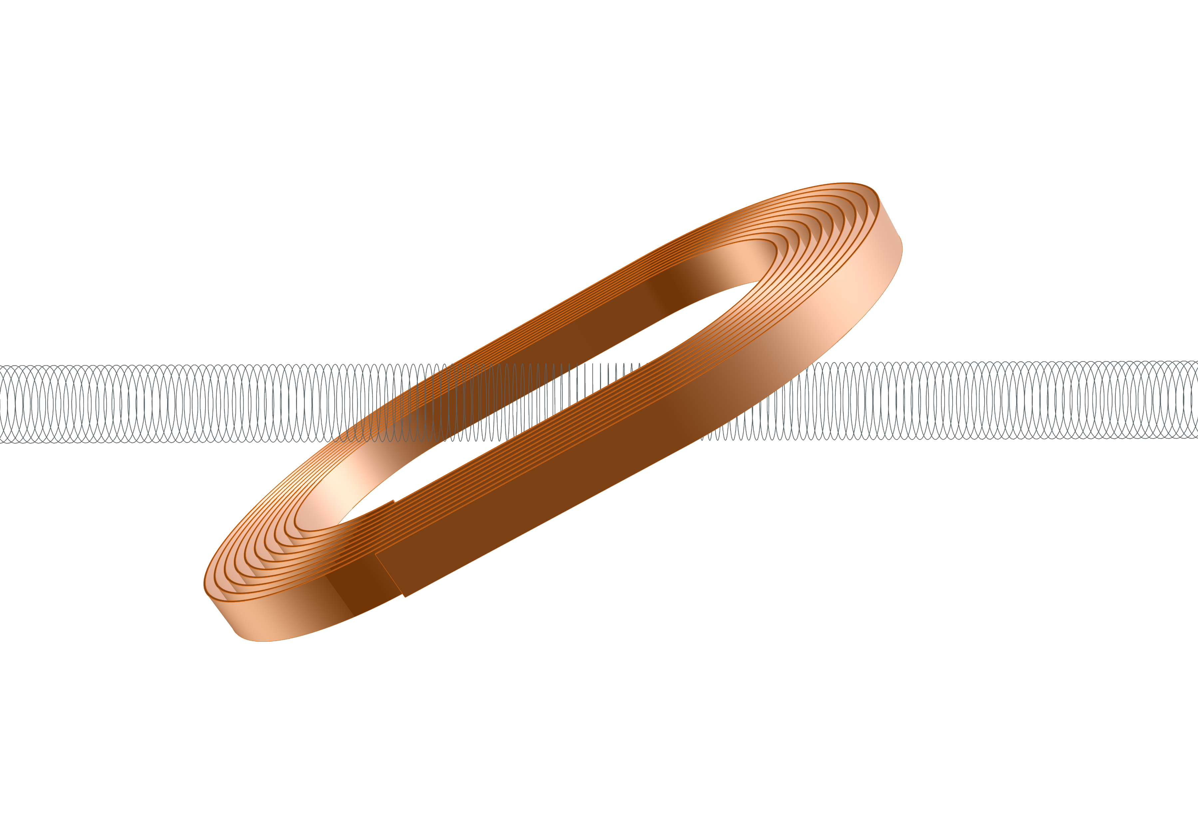
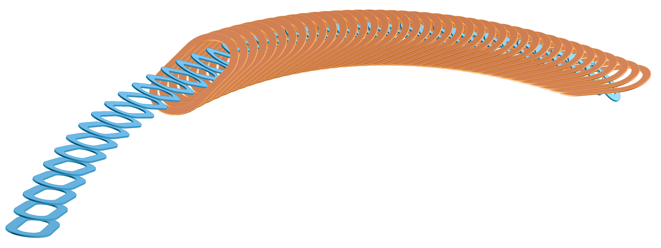
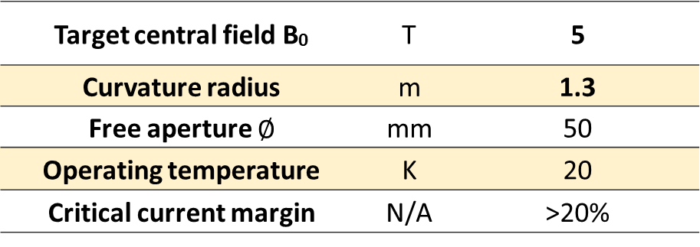
ECHO Magnet: Targets
Canted Cosine Theta - CCT
B
B
Extremly Curved Hadrontherapy Optics (ECHO) Magnet:
Gantries and particle accelerators for hadrontherapy.
Demonstrating the Technological Readiness Level (TRL) of High Temperature Superconductors (HTS)
Energy saving with respect to classical
Low Temperature Superconductors (LTS)
Modular design assembled in a curved geometry
Inner layer
Outer layer
Beam-pipe
Target central field B₀ | T | 5
Curvature radius | m | 1.3
Free aperture $∅$ | mm | 50
Operating temperature | K | 20
Critical current margin | N/A | >20%
Inner layer
Outer layer
Notes:
Rivisitando nota geometria CCT

Slide 6
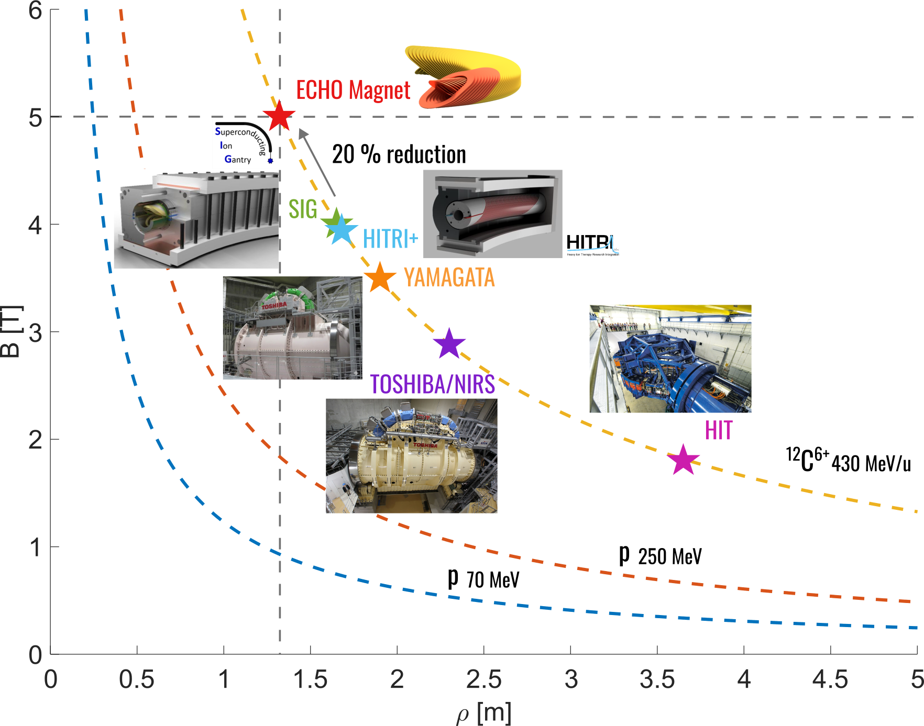
State-of-the-art & actual R&D
Resistive magnets for ion gantry:
  HIT: B = 1.8 T, ρ = 3.65 m
  650 tons
B = 5 T, ρ = 1.3 m
Low Temperature Superconductors (LTS)
  Toshiba/NIRST: B = 2.88 T, ρ = 2.3 m,
    300 tons
  Yamagata: B = 3.5 T, ρ = 1.9 m
    200 tons
  SIG: B = 4 T, ρ = 1.65 m
  HITRI+: B = 4 T, ρ = 1.65 m
High Temperature Superconducting (HTS) tapes are promising candidates
m ~ 100 tons

Slide 7
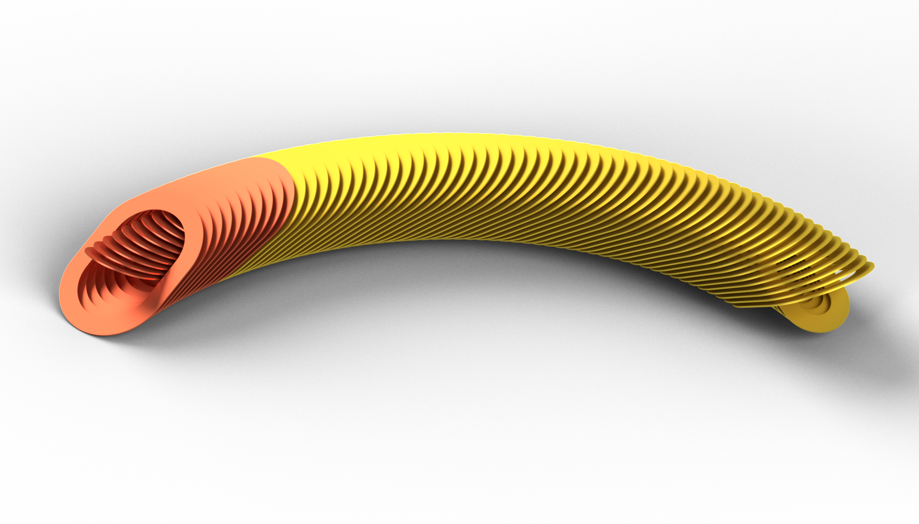
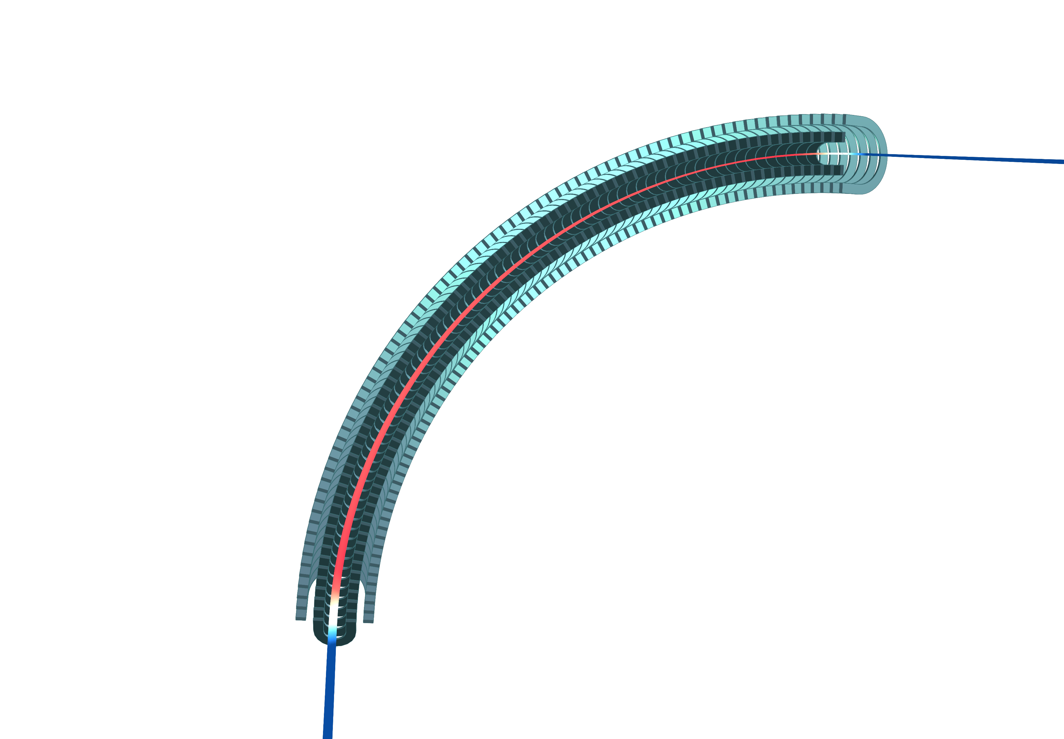
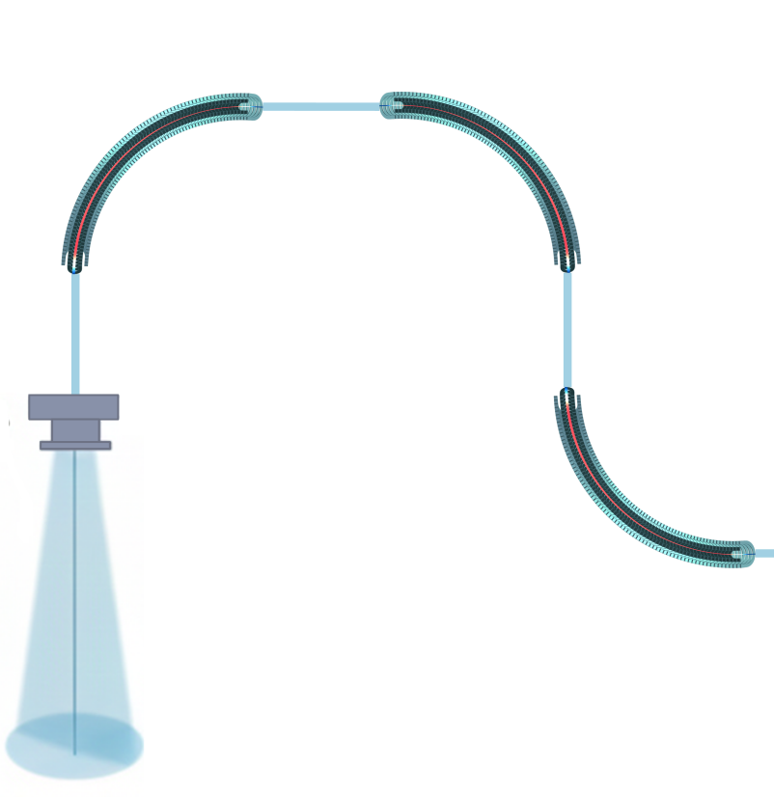
ECHO Magnet: Advantages
Given the state of the art on SC dipole magnets for hadrontherapy ECHO magnet introduces:
Operation at 20 K liquid He free
  x5 energy saving factor with respect to 4.2 K (just for COP)
Modular design: industrialization and scalability
Target central field of 5 T
  20 % reduction of the curvature radius ρ
QA procedure at 77 K granted by HTS
Bending Dipoles - ECHO
ρ
Scanning Magnet
Particle Accelerator
Treatment Room

Slide 8
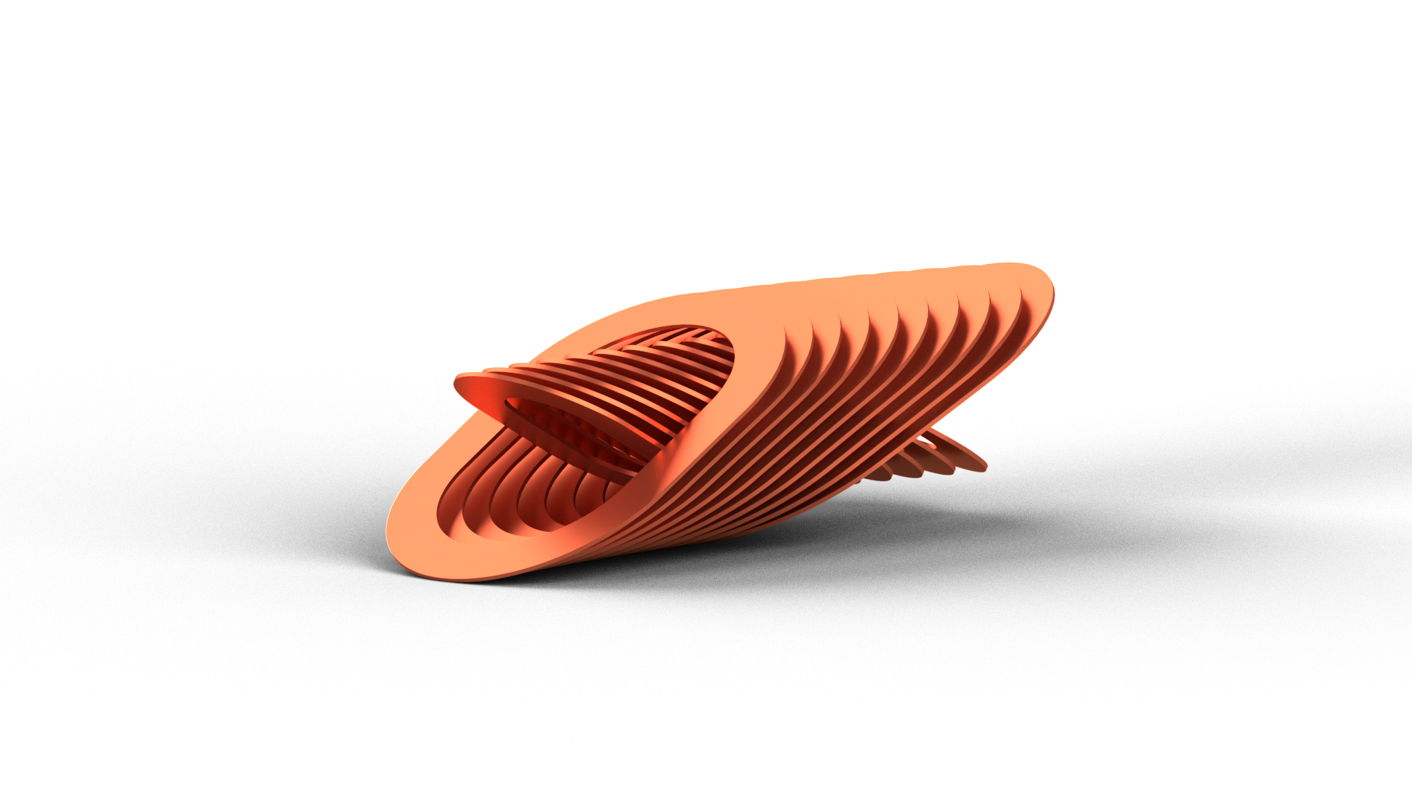
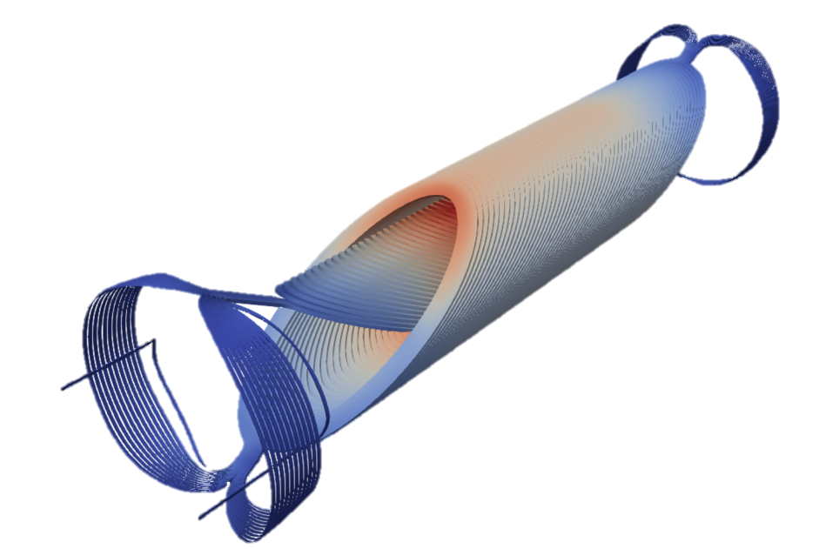






Dipolar HTS magnet towards ECHO
Courtesy of
E. De Matteis
IRIS dipole - ESMA
I.FAST CCT dipole
ECHO Magnet
Pros
Flat coils → windability
High field (10 T)
Solid design
Cons
Straight geometry
± 1.5 % field quality
Pros
Field quality
No inner junctions
Cons
Straight geometry
Complex helix-winding
Critical external junctions
Pros
Flat coils → windability
Curved geometry
Field quality
Scalability
Cons
Modules assembly on curved support
Resistive joints

Slide 9
Roadmap of activities for ECHO
Phase 1
Characterization of HTS tape
Electrical
Thermal and Mechanical
Single module design and challenges
Phase 2
Modules manufacturing
Mechanical Assembly
Final Testing

Slide 10
Roadmap of activities for ECHO
Phase 1
Characterization of HTS tape
Electrical
Thermal and Mechanical
Single module design and challenges
Phase 2
Modules manufacturing
Mechanical Assembly
Final Testing

Slide 11
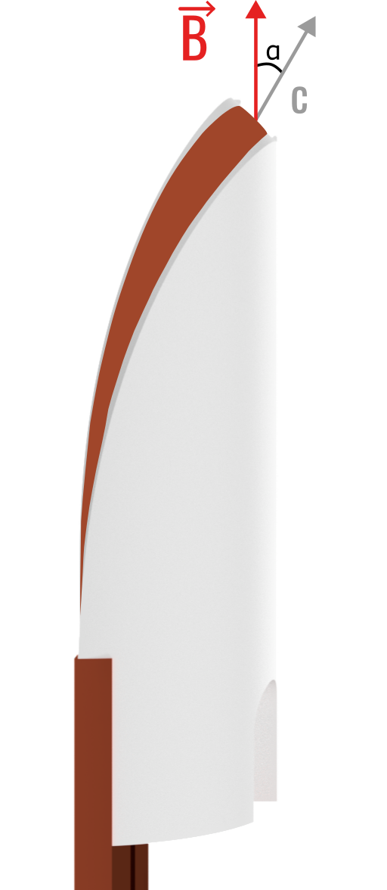
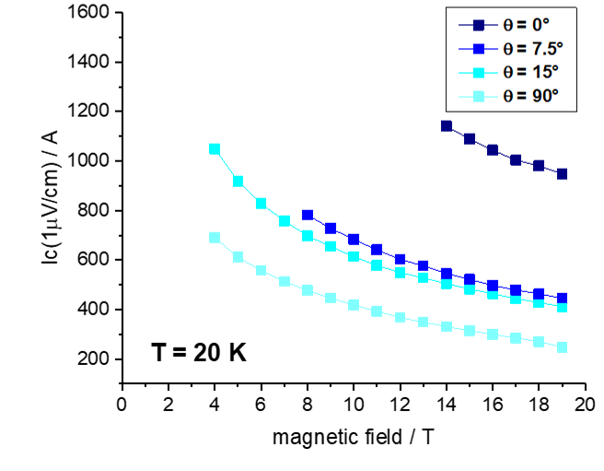
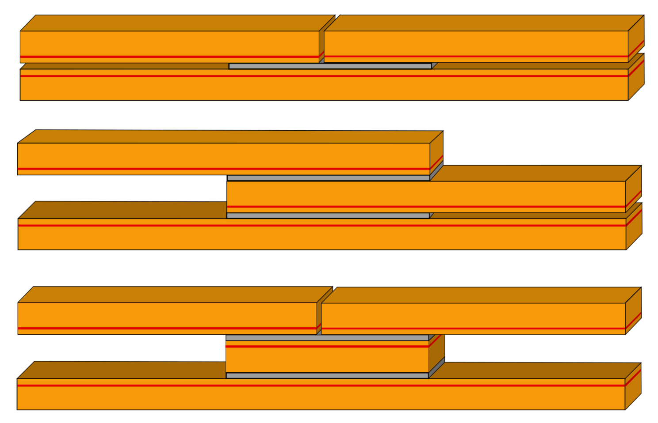
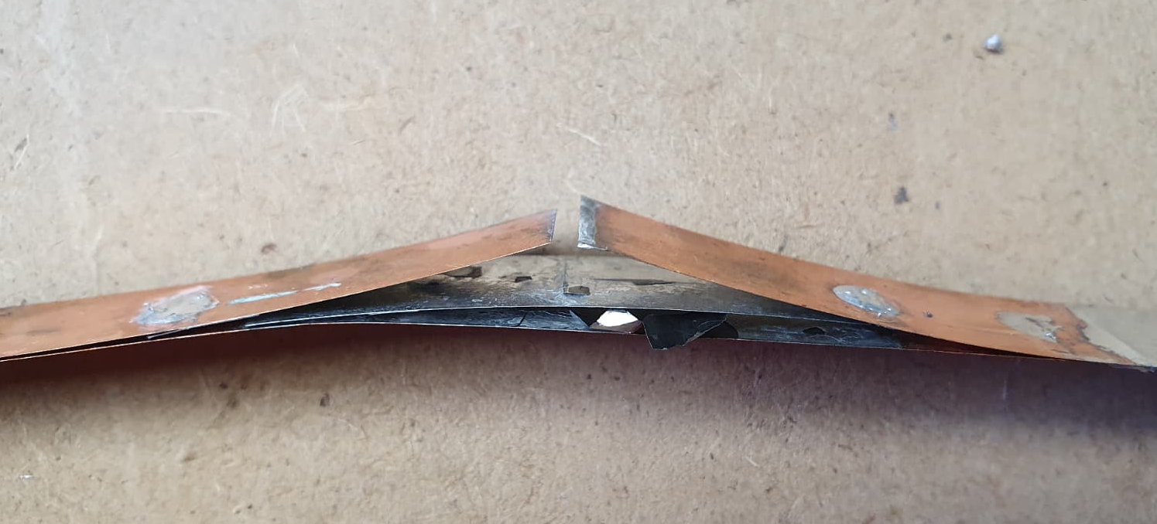
Phase 1: Characterization of HTS tape
Electrical
Courtesy of C. Senatore, University of Geneva
Electrical properties are fundamental to drive the electromagnetic design of each module:
HTS tape critical current dependencies:
  Temperature
  Magnetic field
  Angular
Optimization of resistive splices
  Within each module
  Inter-module
HTS tape
Insulating guide
Simple Flat
Lap
Bridge
Joint Failure

Slide 12
Roadmap of activities for ECHO
Phase 1
Characterization of HTS tape
Electrical
Thermal and Mechanical
Single module design and challenges
Phase 2
Modules manufacturing
Mechanical Assembly
Final Testing

Slide 13
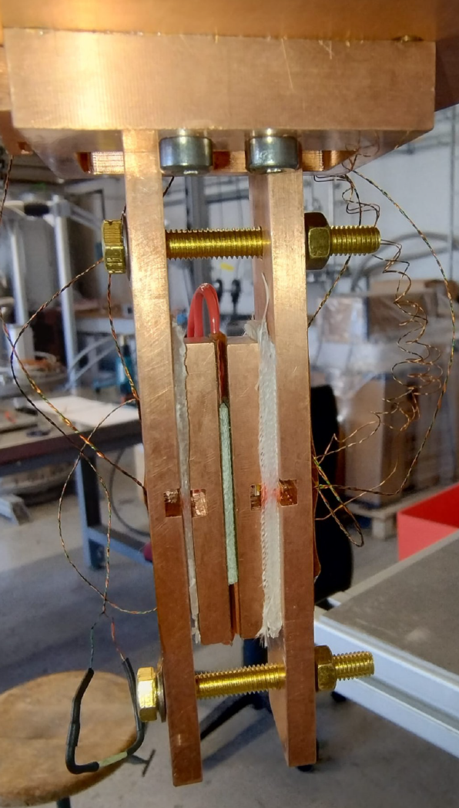
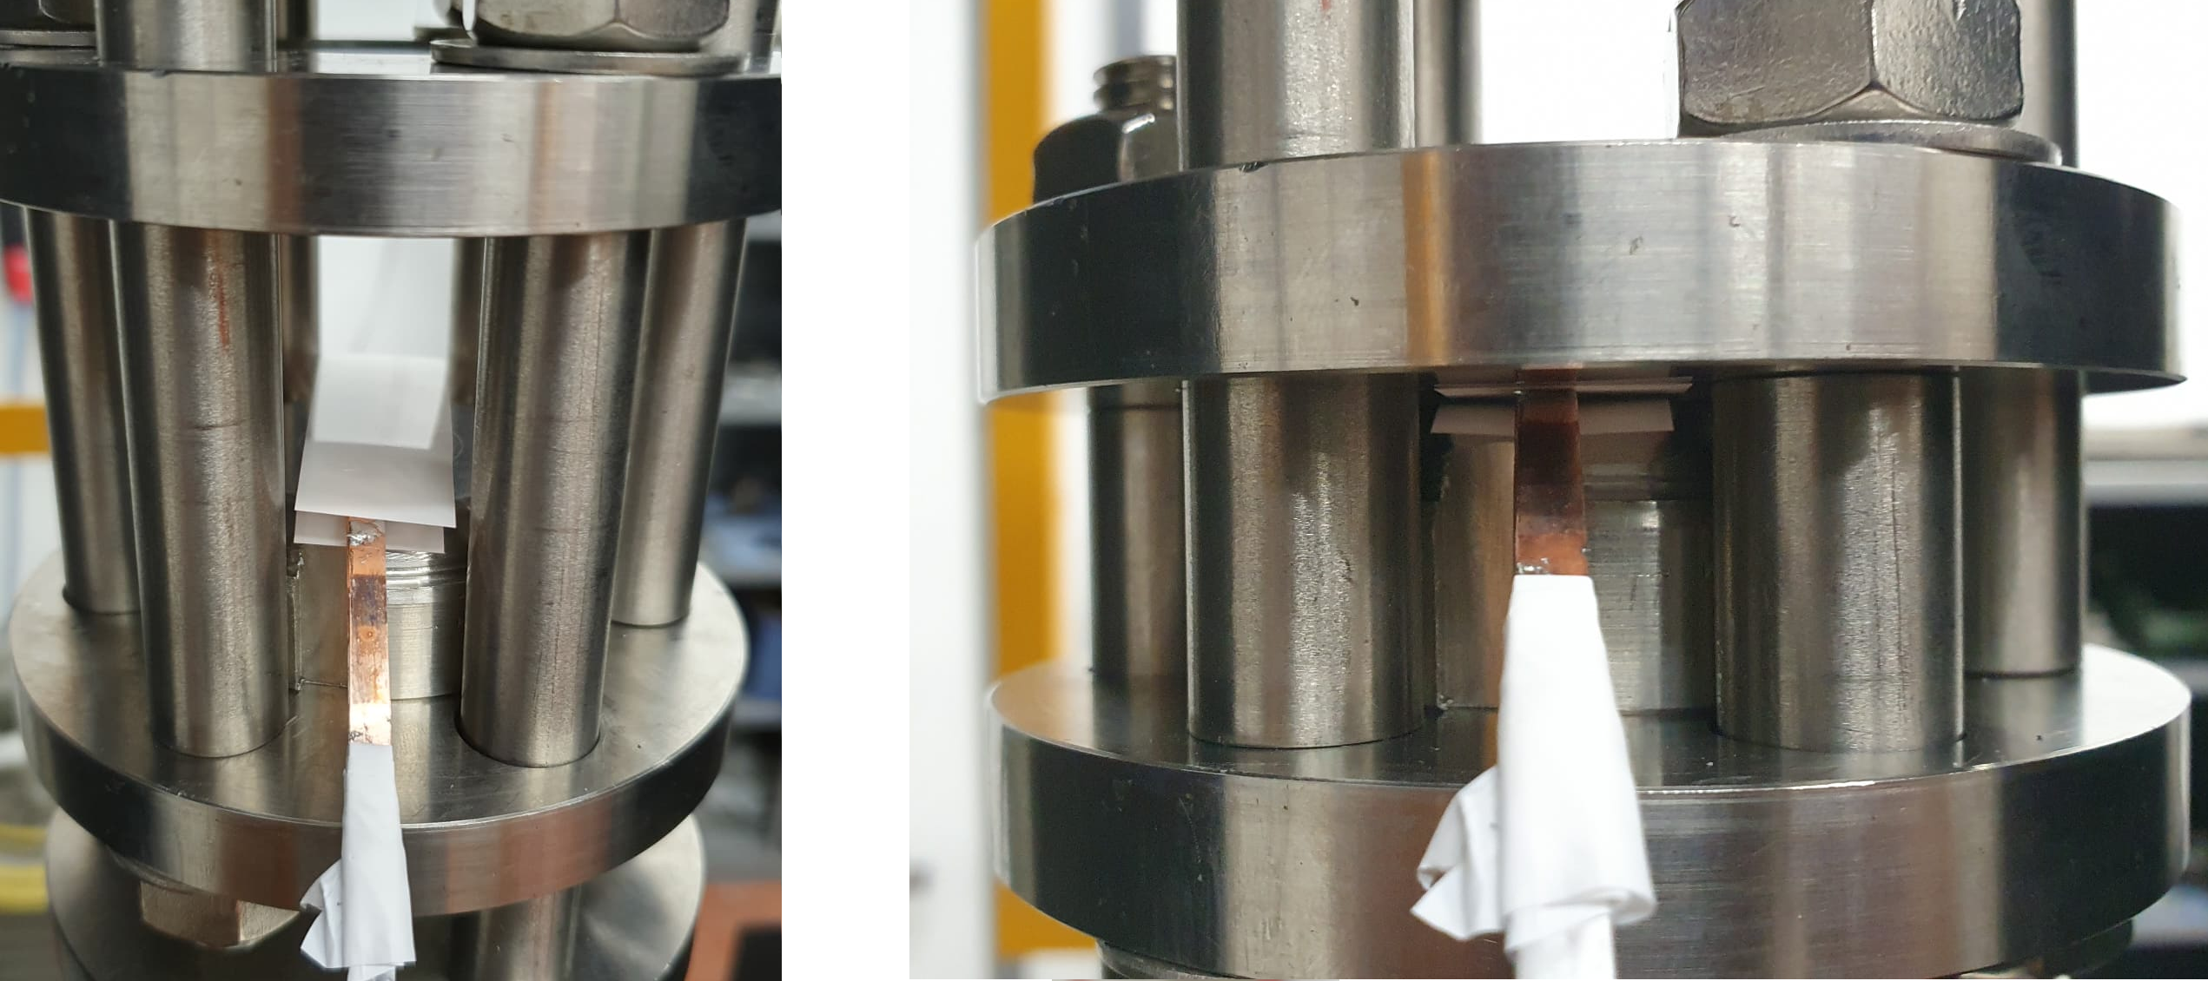
Phase 1: Characterization of HTS tape
Thermal and Mechanical
Thermal and mechanical properties will be studied for different cables configurations:
Thermal conductivity
  Dry-wound
  Impregnated
Lower than expected Young’s modulus
  Dry-stack
  Impregnated stack

Slide 14
Roadmap of activities for ECHO
Phase 1
Characterization of HTS tape
Electrical
Thermal and Mechanical
Single module design and challenges
Phase 2
Modules manufacturing
Mechanical Assembly
Final Testing

Slide 15
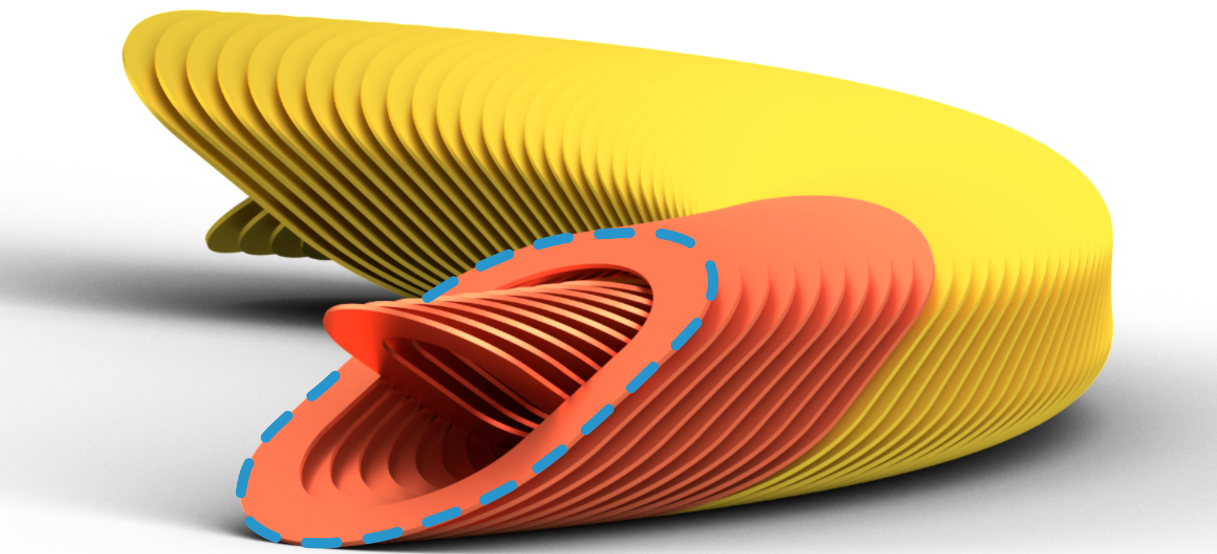
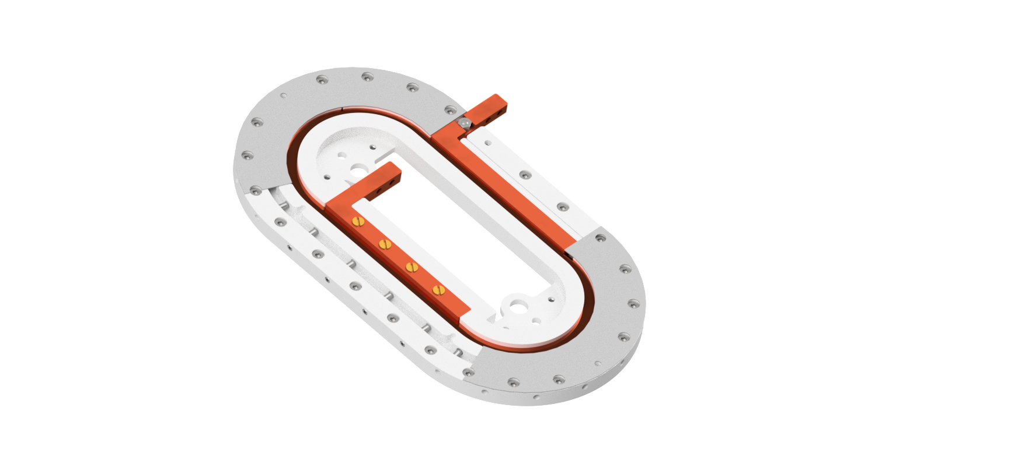
Phase 1: Single module design
A small HTS racetrack coil design aiming at one ECHO module will be performed.
The design must assess the following question:
Realize a solid design with operational margins
Achieve a repeatible field quality
Optimize resistive joints
Handle the assembly on a curved support
Set up a QA procedure in LN₂
  Modularity and repeatibility of the process
Conceptual Single Module

Slide 16
Roadmap of activities for ECHO
Phase 1
Characterization of HTS tape
Electrical
Thermal and Mechanical
Single module design and challenges
Phase 2
Modules manufacturing
Mechanical Assembly
Final Testing

Slide 17
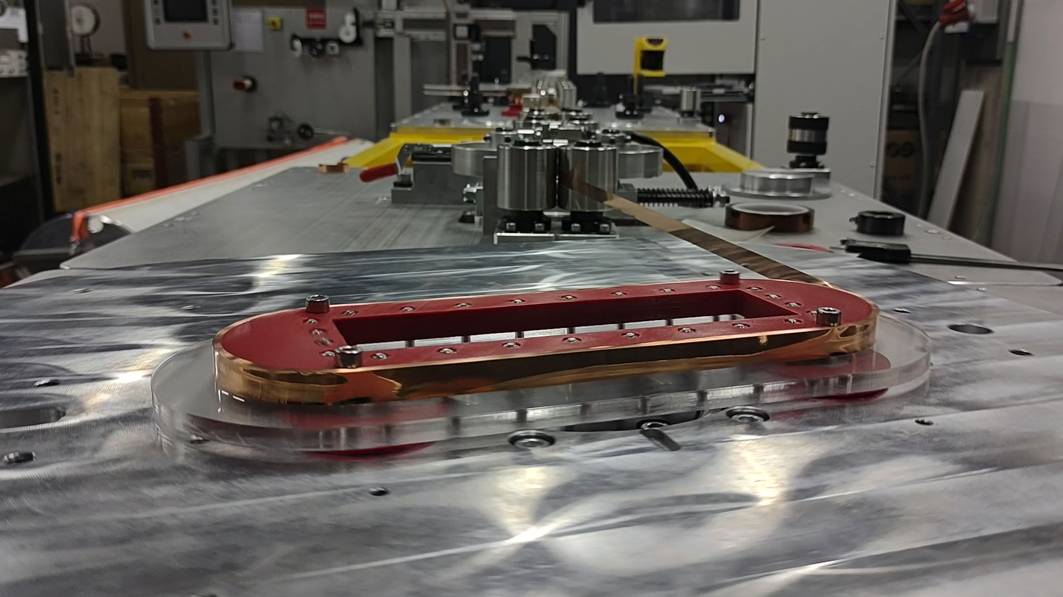
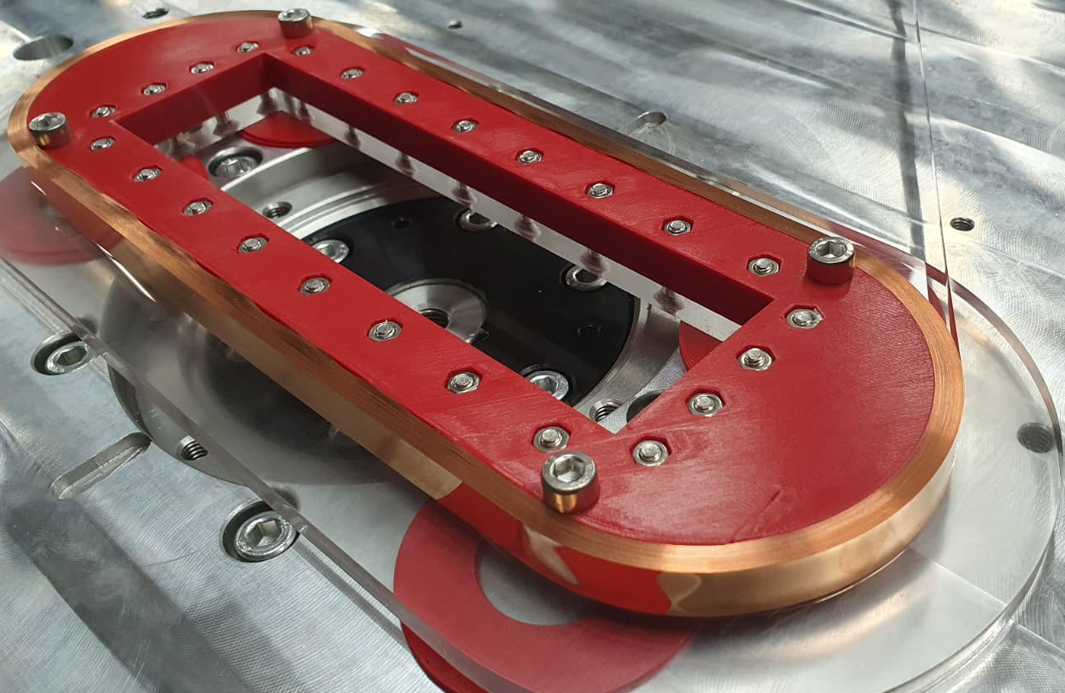
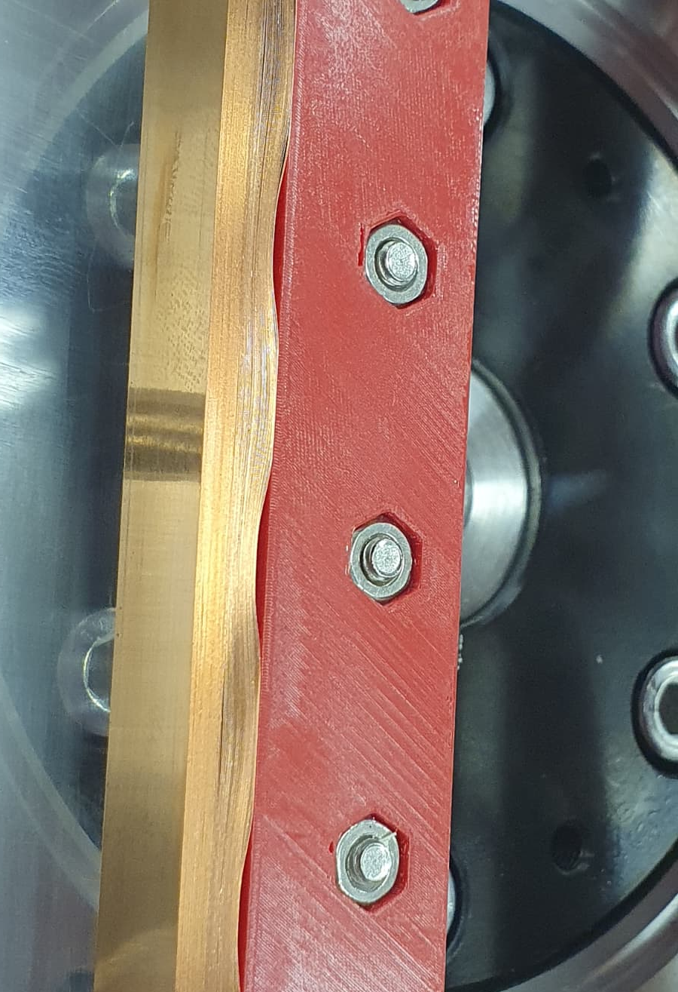
Phase 2: Module Manufacturing
Winding test: single tape on plastic mandrel
The winding of each ECHO module will be carried out considering:
Different winding technologies using a multi-tape winding machine:
  Up to 6 tapes in parallel.
  Variable and controlled winding tension.
A classical racetrack geometry suffers from buckling:
  Alternatives/mitigations will be studied.

Slide 18
Roadmap of activities for ECHO
Phase 1
Characterization of HTS tape
Electrical
Thermal and Mechanical
Single module design and challenges
Phase 2
Modules manufacturing
Mechanical Assembly
Final Testing

Slide 19
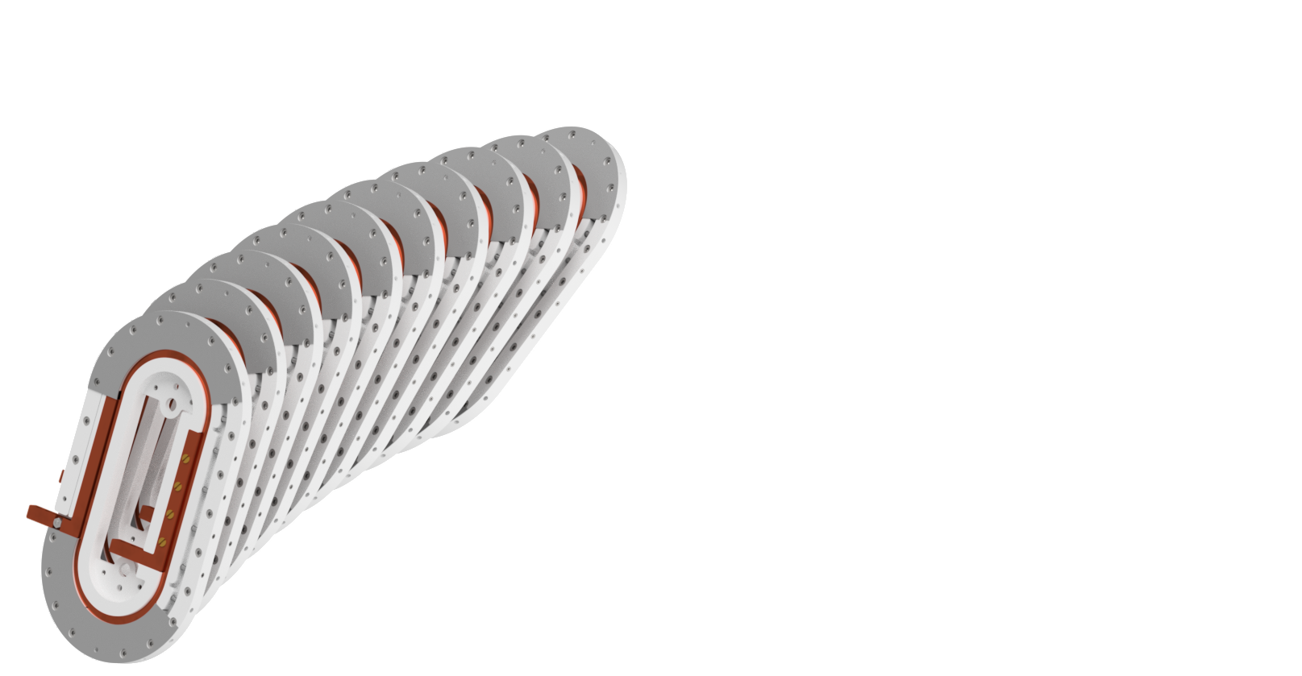
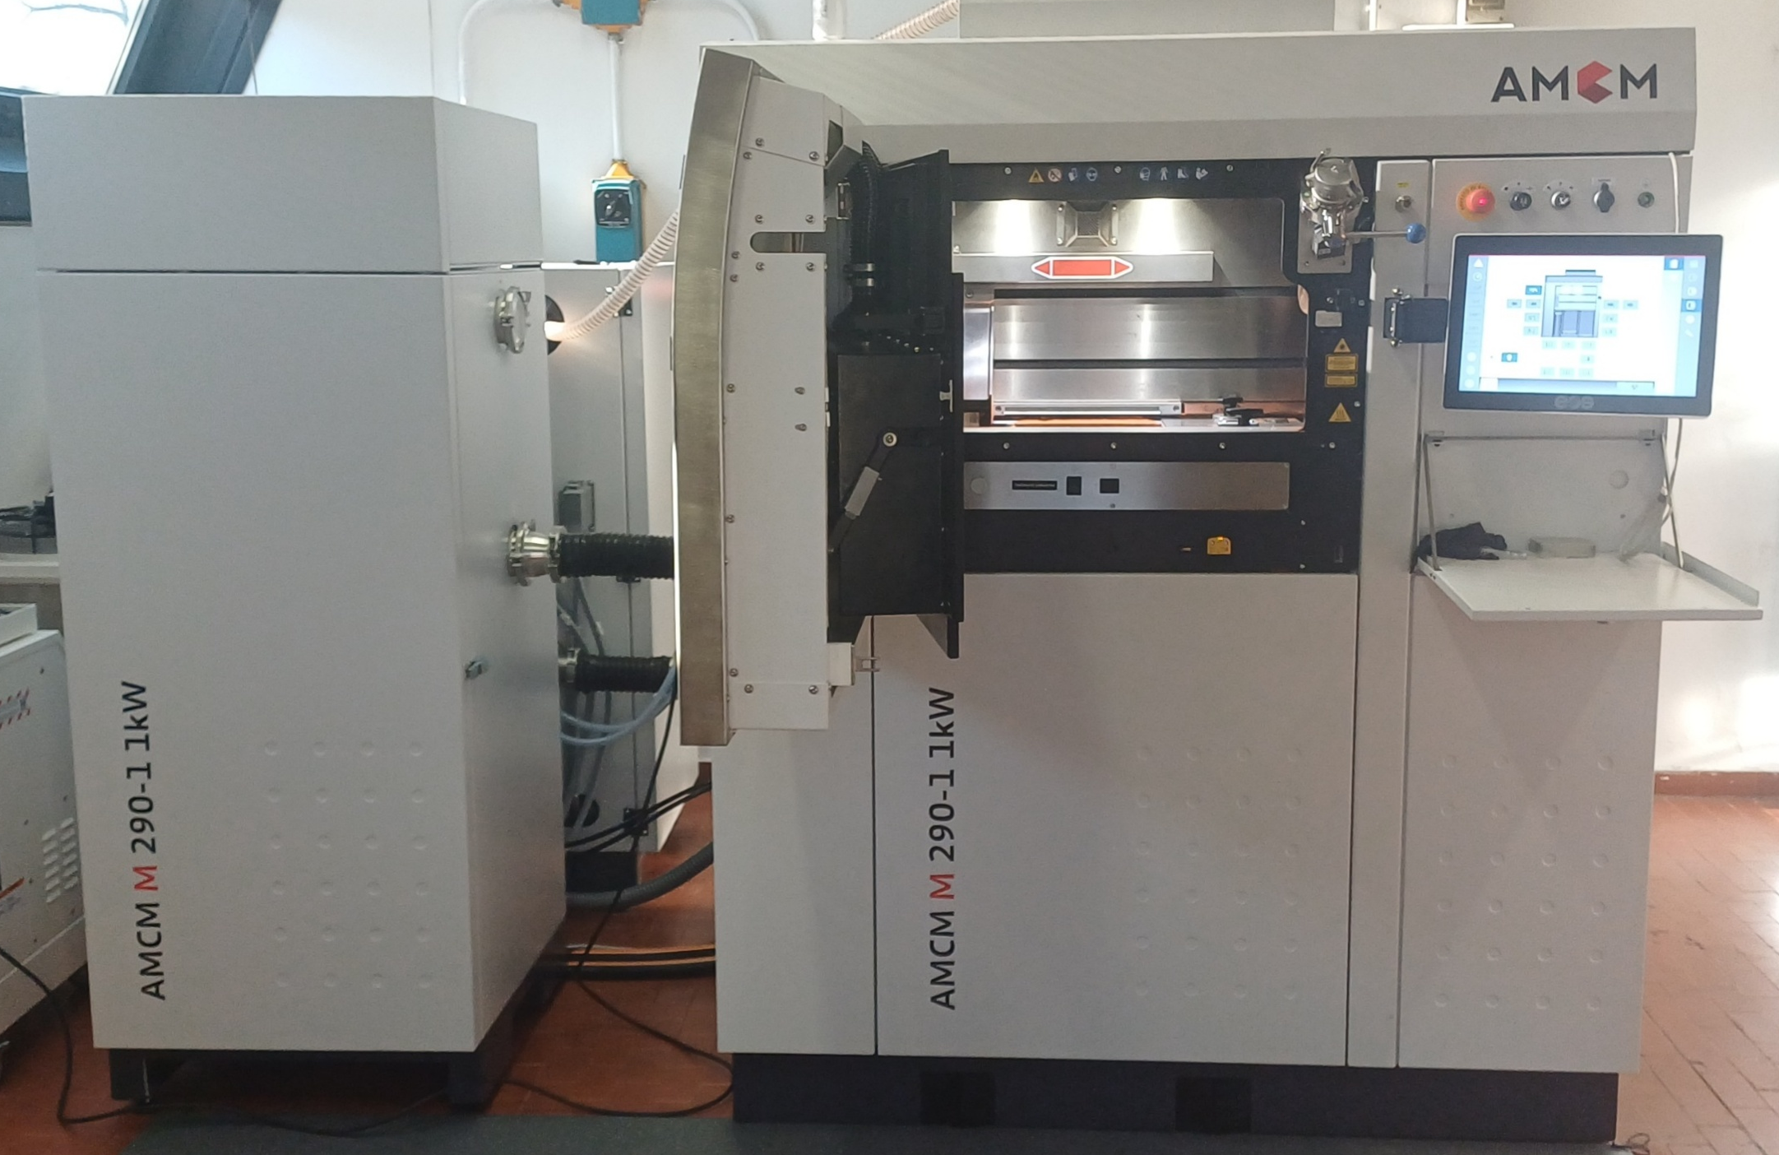
Phase 2: Mechanical assembly
The manufacturing of the ECHO module will be carried out considering:
Integrating the mechanic of each module with the curved support
Optimization of resistive junctions between modules
Possibility to exploit metallic additive manufacturing:
  Copper
  Stainless steel

Slide 20
Roadmap of activities for ECHO
Phase 1
Characterization of HTS tape
Electrical
Thermal and Mechanical
Single module design and challenges
Phase 2
Modules manufacturing
Mechanical Assembly
Final Testing

Slide 21
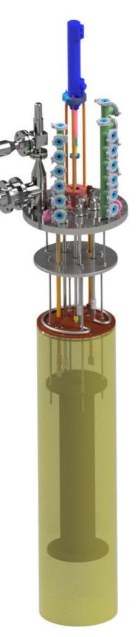
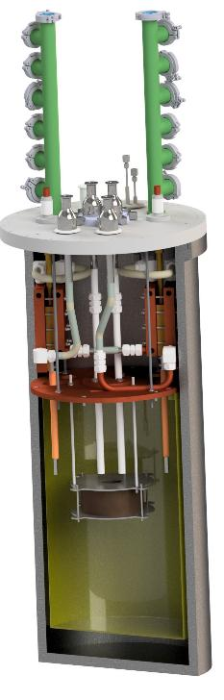
Phase 2: Final testing
Tests at 20 K will be carried out inside the IRIS variable temperature test stand for HTS magnets:
Closed loop cooling 20 K – 50 K
Based on cryocoolers and closed loop
G-Helium :
  20 W @ 20 K
  (Adjustable T from 20 K to 50 K)
  300 W @ 55 K
HiLumi
D 450 mm
h 1910 mm
8 T
SOLEMI insert
D 450 mm
h 720 mm

Slide 22


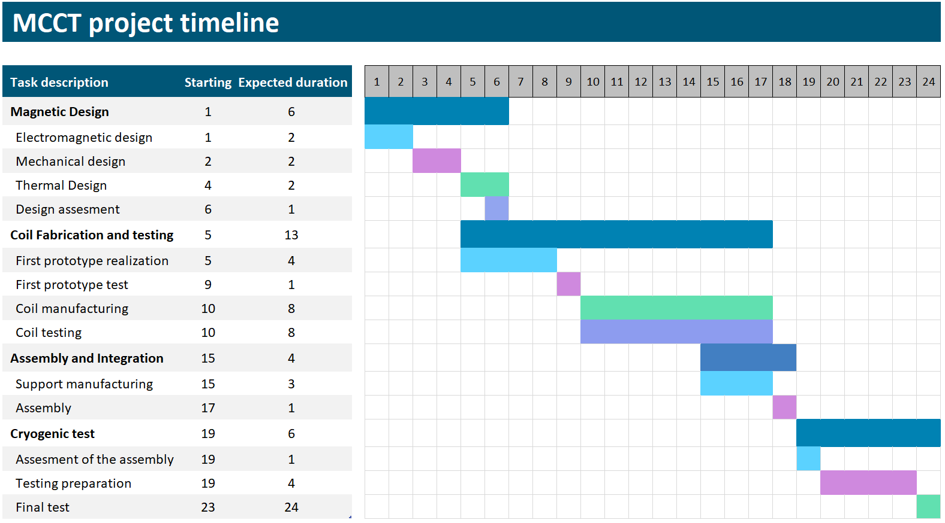
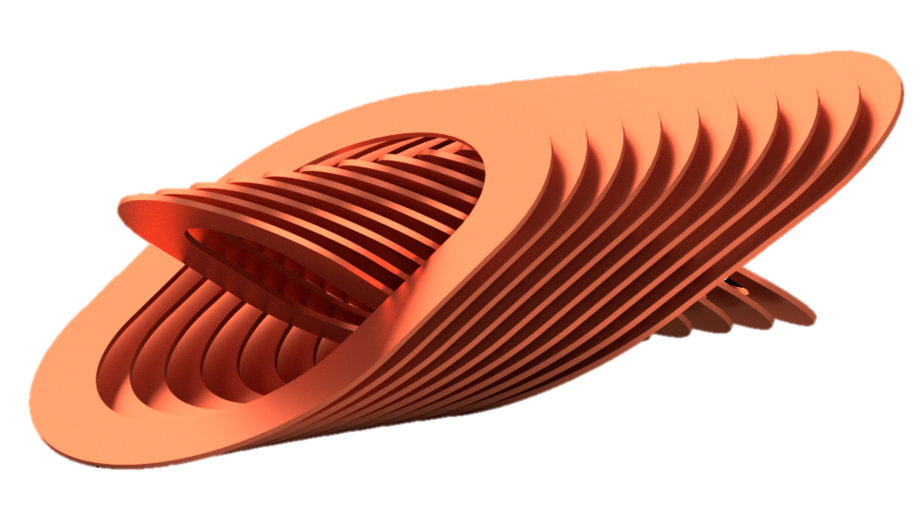
Project timeline
Milestones:
Deliverables:
3
5
First 10 coils
18
20
24
1
Notes:
FTE x tecnici (1.4/2)
Assessment of the assembly, specificare bene del magnete finale (parte arancione della figura iniziale)
M1 (Month 6) – Completion of full 3D electromagnetic and mechanical model.
M2 (Month 10) – Successful winding and LN₂ testing of the first HTS coil module.
M3 (Month 14) – Completion of 10 coil modules with validated performance.
M4 (Month 20) – Completion of full mechanical assembly of the short MCCT prototype.
M5 (Month 24) – Completion of cryogenic testing at 20 K.
D1: Conceptual design report.
D2: Fabrication and testing logs for a HTS racetrack coil modulus, at LN₂ temperature.
D3: Assembling report of the short prototype magnet.
D4: Final test report.

Slide 23
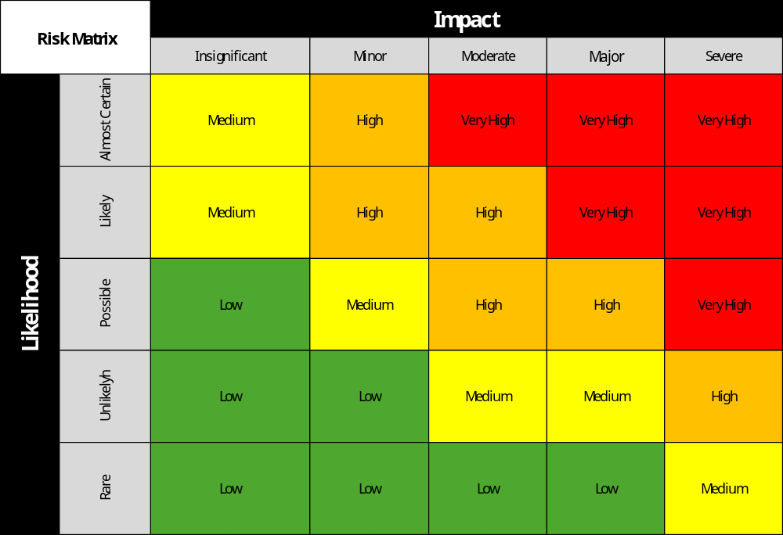
Risks and costs summary
About the risk analysis:
Risks are mainly calculated from the experience accumulated in the design and manufacturing of ESMA
Windability may be affected by the chosen geometry and superficial homogeneity of the tape
Protection and thermal budget must be carefully addressed, as well as field quality
Field Quality
HTS defects
Protection
Test issues
Windability
Notes:
Mit for defects: 1: cut the weak portion of the cable and joint. 2: remove. 3: targeting shorter batches of 4 mm wide (or narrower) tape which have proven to be manufactured in a more controlled way.
Mit for prot: Anticipate a quench with an early detection. A further measure could be to pass from insulated to Controlled Resistance (CI) mode.
Mit for FQ: 1: in the design phase consider a narrow tape; 2: during testing, we will verify that the errors are stable ramp-to-ramp, such as to implement feed-forward correcting strategies.
Mit for win: more demanding specs or winding tension profile.
Mit for cryogenic: enhance cooling power or run a temporary test in Lhe or LN2

Slide 24
Risks and costs summary
Main mitigations:
Field quality: in the design phase consider a narrow tape (4 mm, or less).
Protection: pass from insulated to Controlled Resistance (CI) mode.
Defects: cut the weak portion of the cable and optimize joint procedure.
Test issues: Increase the cooling power with a suitable additional variable temperature heat exchanger.
Windability: Ask for more demanding thickness specification to the manufacturerand act on the design of the flat coil geometry.
HTS defects
Field Quality
Protection
Test issues
Windability
Notes:
Mit for defects: 1: cut the weak portion of the cable and joint. 2: remove. 3: targeting shorter batches of 4 mm wide (or narrower) tape which have proven to be manufactured in a more controlled way.
Mit for prot: Anticipate a quench with an early detection. A further measure could be to pass from insulated to Controlled Resistance (CI) mode.
Mit for FQ: 1: in the design phase consider a narrow tape; 2: during testing, we will verify that the errors are stable ramp-to-ramp, such as to implement feed-forward correcting strategies.
Mit for win: more demanding specs or winding tension profile.
Mit for cryogenic: enhance cooling power or run a temporary test in Lhe or LN2

Slide 25
Risks and costs summary
Costs analysis considered:
Tape quotation was obtained addressing medium performance, commerically available 4 mm HTS tape
Mechanical components for each coil were based on a preliminary design for small HTS racetrack coil
Curved mechanical supports and cryogenic tests component are based on SIG mechanics and from the preparation of the test of a single ESMA coil
Object | Year | Cost [€] | Cost + IVA [€]
3 km of HTS tape | 1+2 | 55 500 | 67 710
Coils mechanical components | 1 | 22 800 | 27 816
Curved mechanical supports | 2 | 12 250 | 14 945
Cryogenic test components | 2 | 25 300 | 30 866
Presentation at conferences | 1+2 | 3 600 | 3 600
Total | 1+2 | 119 450 | 144 937

Slide 26
Final recap and conclusions
Given the expertise gained from INFN-led project as SIG e HITRI+ on SC gantry, a classical CCT design was adapted to be realized in a modular structure:
  The goal is to realize a small-scale HTS dipole magnet demonstrator consisting of 10 modules for each layer.
The project sets the first milestone towards a next generation of ion gantries introducing:
  Energy saving.
  Industrial scalability.
  Compact gantries.

Slide 27
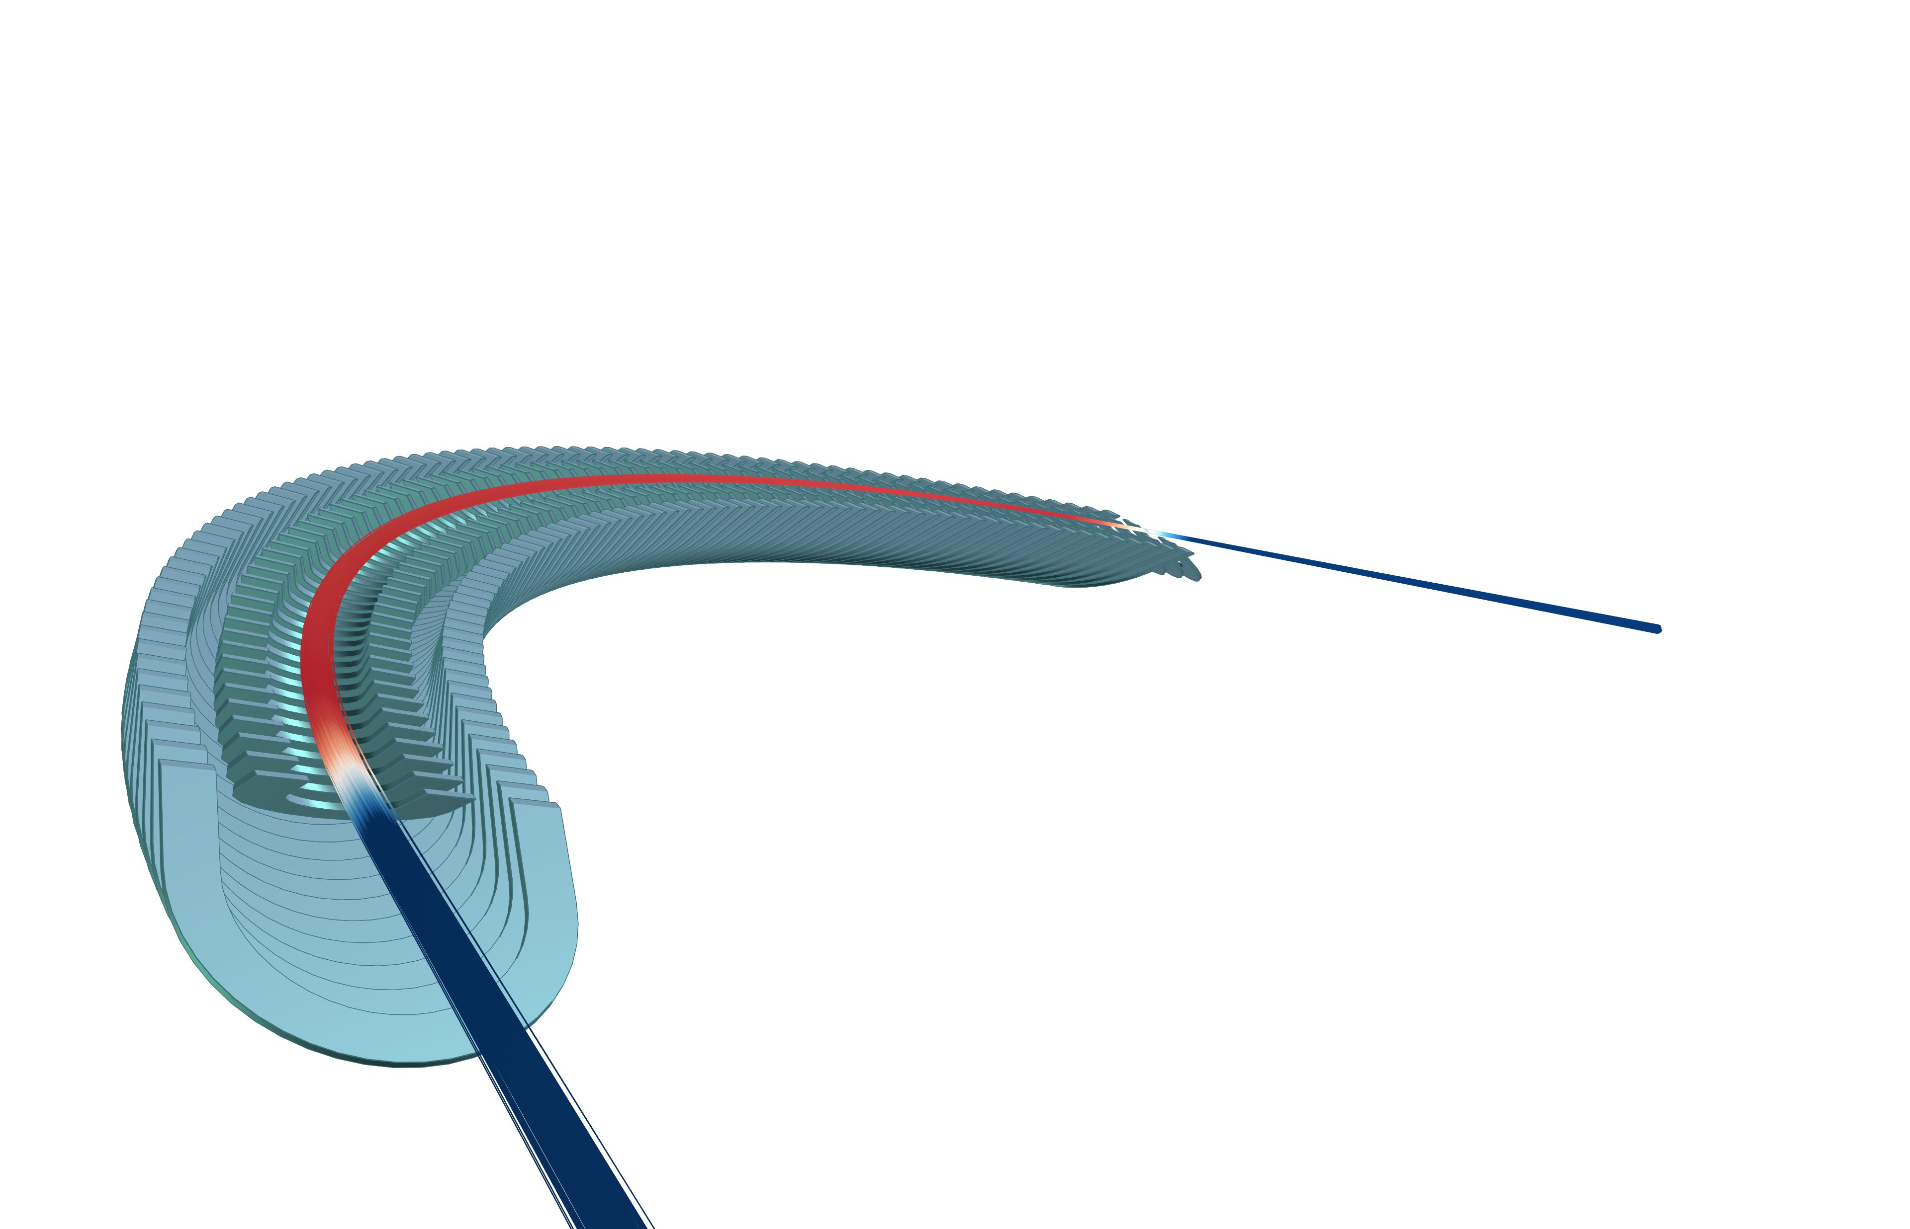
The end

Slide 28
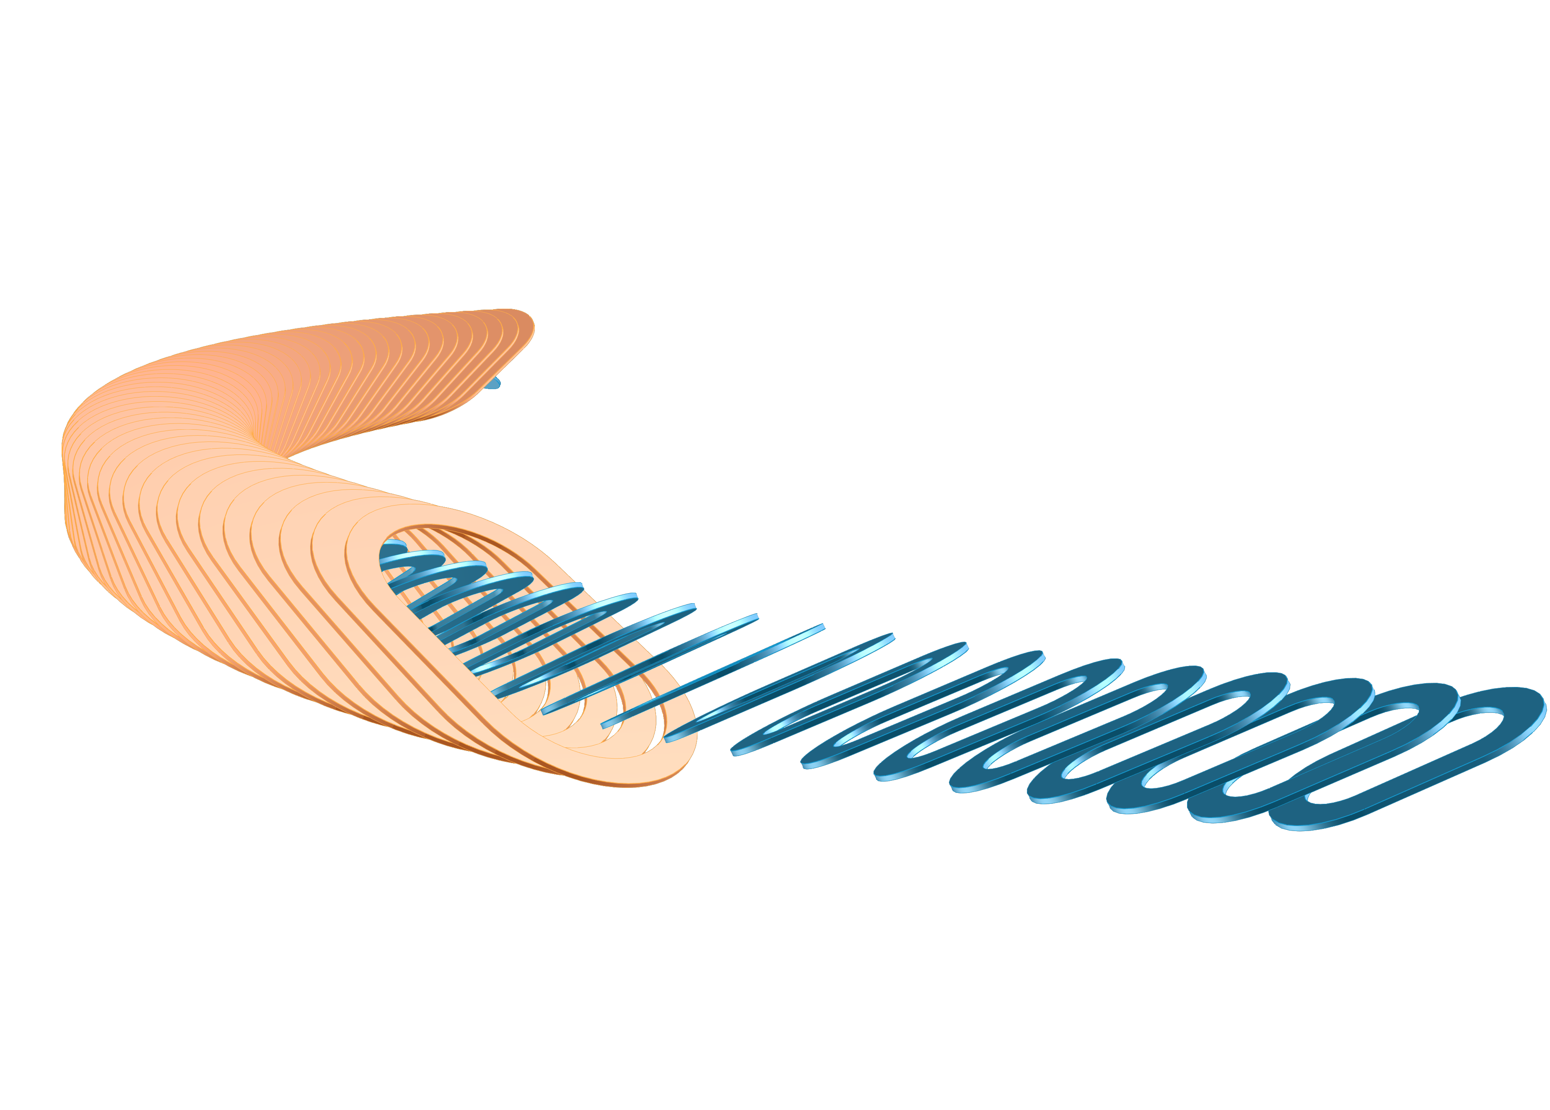
Backup Slides

Slide 29
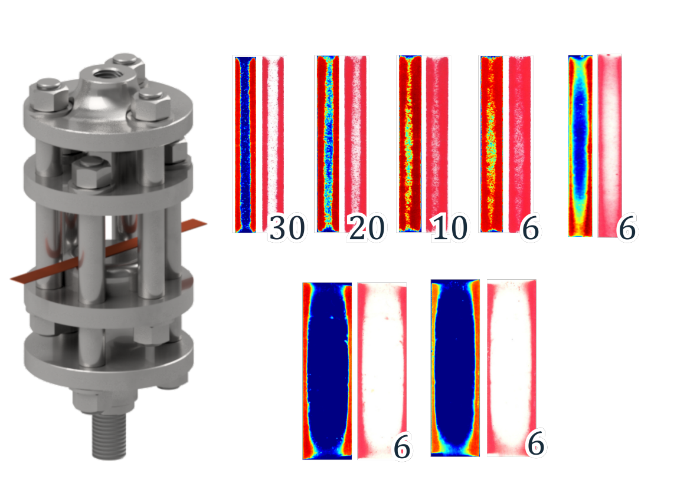
Thickness Inhomogeneity
Tapes may show thickness inhomogeneity commonly referred to as “dog-bone”, occurring during the electroplating of the final copper layer.
This may lead to:
Localized stresses
Winding issues
Supplier Spec 67 µm ± 10% (from 59 µm to 74 µm)
01/12/2025

Slide 30
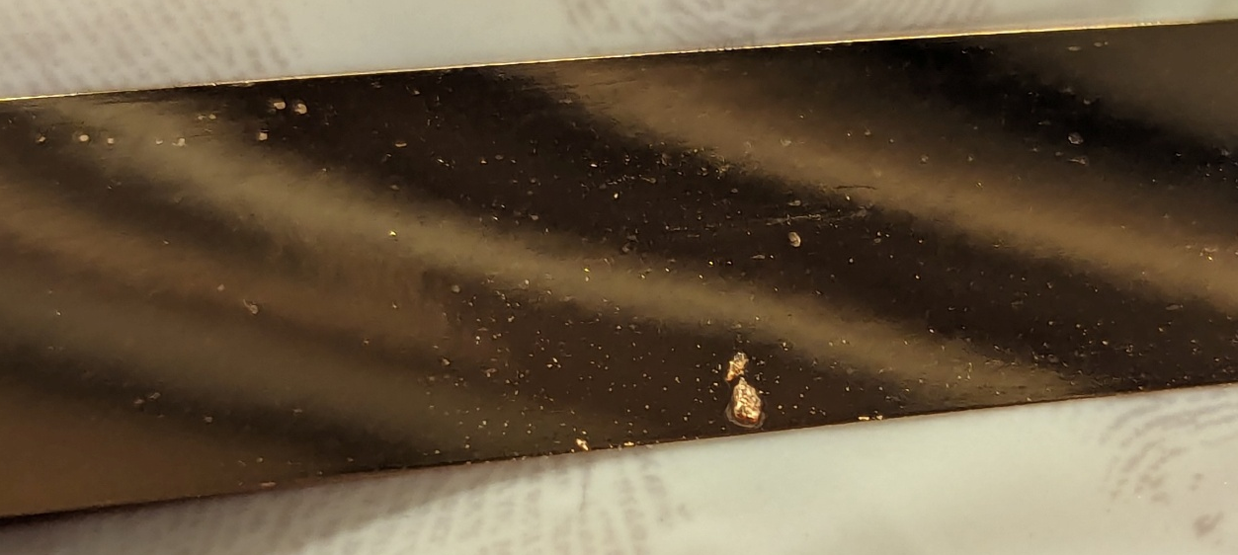
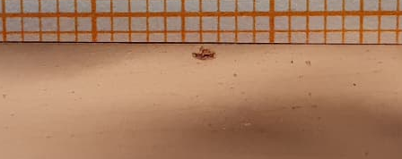
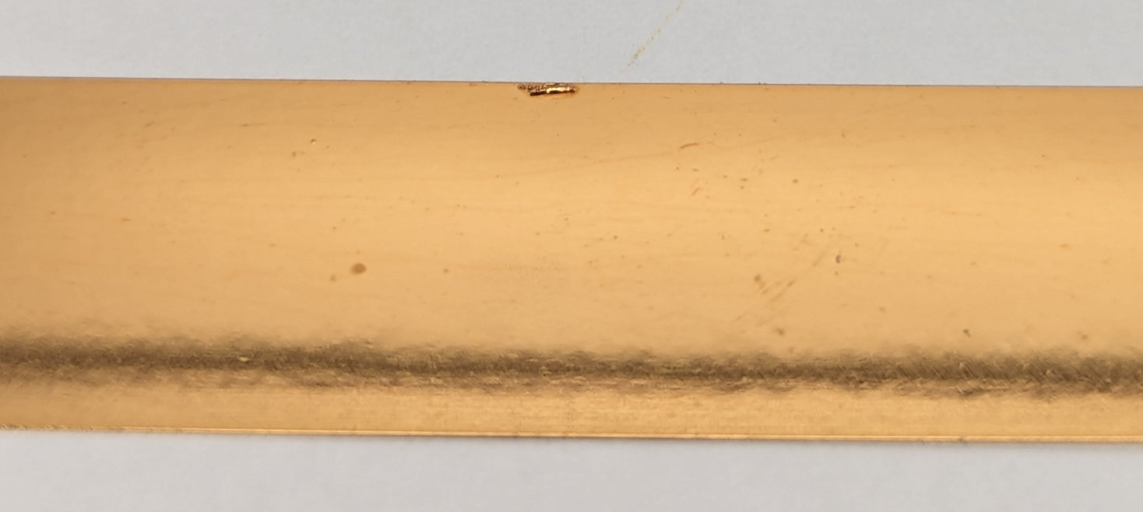
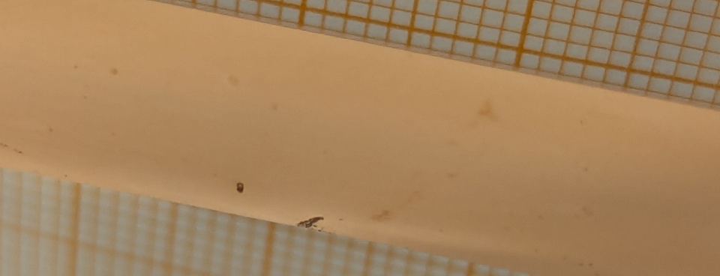
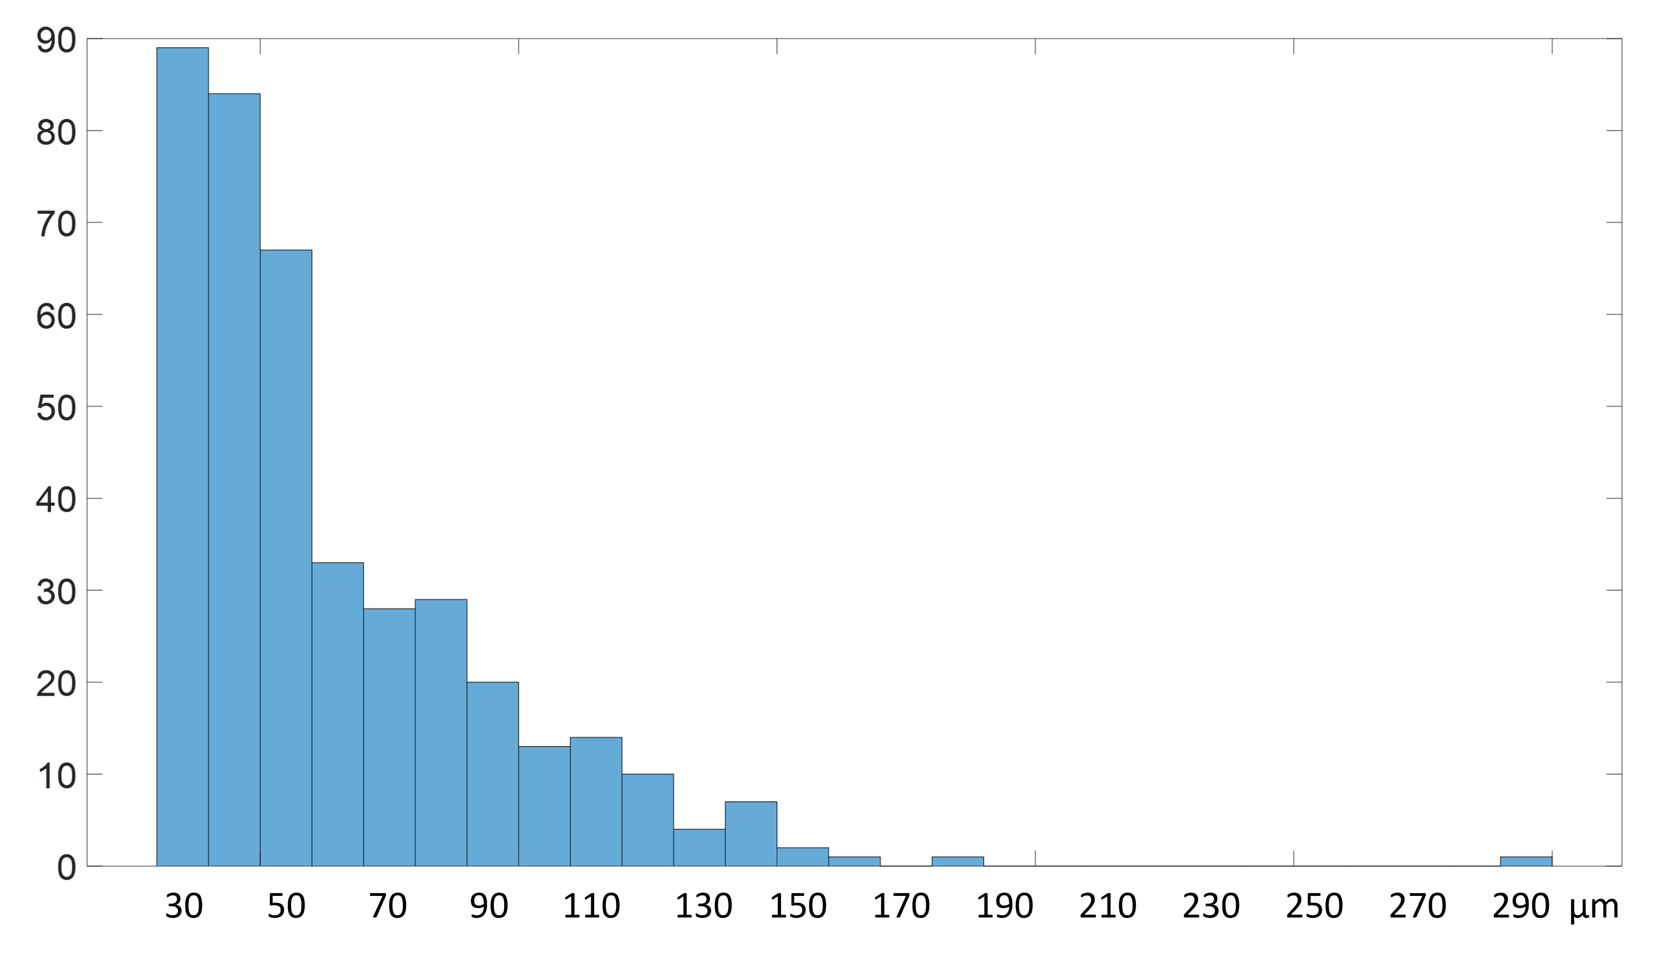
Inclusion Characterisation
64 Spools fully de-spooled and inspected for defects
Minimum Inclusion thickness tracked: 30 µm
Inclusions: > 400
95% Inclusion on the good side (YBCO side)
80% Inclusion on the edge areas
Inclusion Genesis – Silver Sputtering
small silver particles can stick to the rollers in the tape transport system
they stick to the tape surface
they get coated with copper during electroplating
01/12/2025

Slide 31
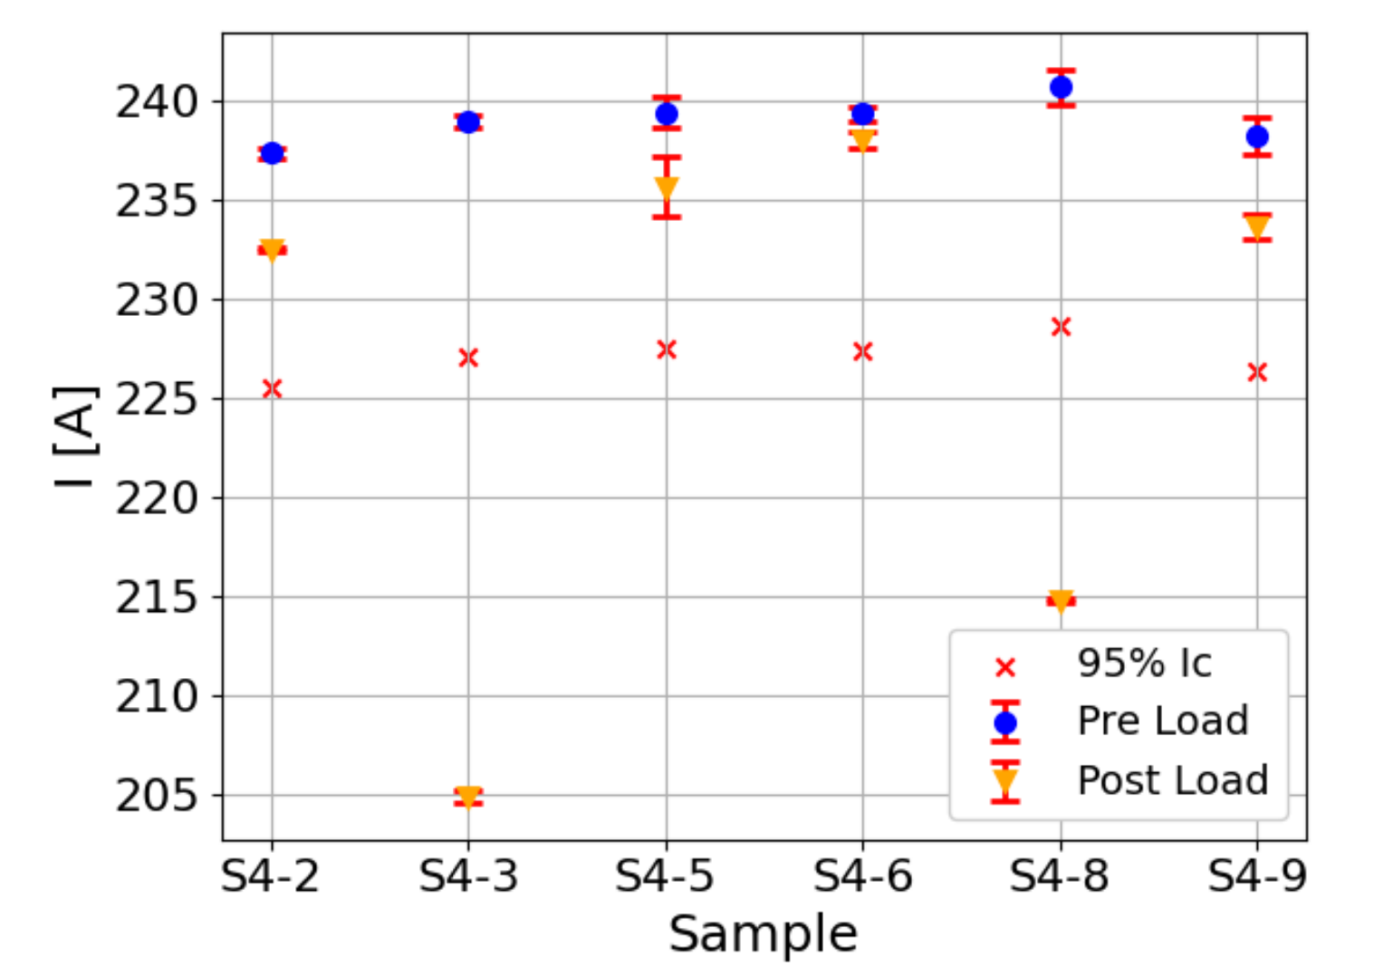
Characterization of HTS stacks
Mechanical measurement will be followed by electrical measurements to assess a possible tape degradation:
Variable uniaxial compressive load
Different stack conditions
01/12/2025

Slide 32
Resources availability
Endorsement of the magnet group leader at LASA for the use of the following resources:
Group technicians for coil assembly and manufacturing up to 2 FTE
01/12/2025

